Slide 1
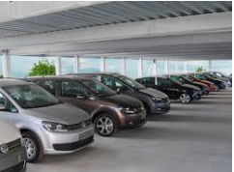
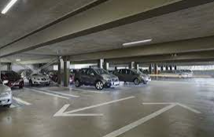
ONLINE PARKING SPACE MECHANISM WITH PRIVACY PROTECTION
Guided by
S.T. Santhana Lakshmi
Femina S 211418104059
Kirthiga N 211418104125
Kiruthika M 211418104126

Slide 2
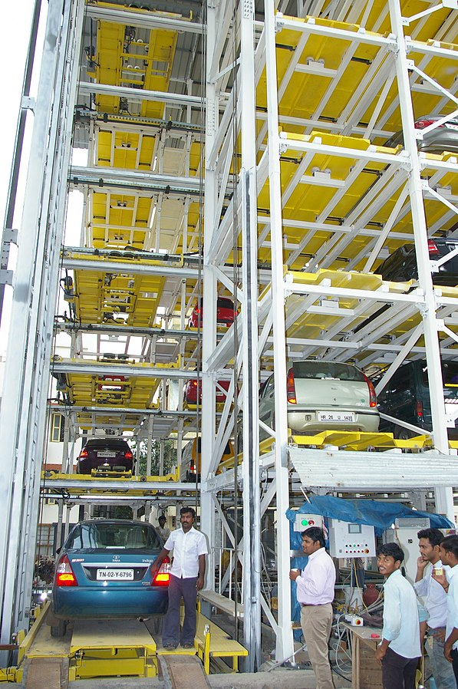
OVERVIEW
CAR PARKING SYSTEM
A car parking system is a mechanical device that multiplies parking capacity inside a parking lot. Parking systems are generally powered by electric motors or hydraulic pumps that move vehicles into a storage position.
Car parking systems may be traditional or automated. Automatic multi-storage automated car park systems are less expensive per parking slot, since they tend to require less building volume and less ground area than a conventional facility with the same capacity.
In the long term, automated car parking systems are likely to be more cost effective than traditional parking garages. Car parking systems reduce exhaust gas that is cars need not drive around in search of street parking spaces.
Super Saravana Stores Automatic Car Parking System

Slide 3
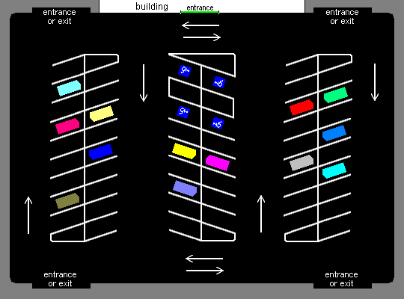
PARKING LOT
A parking lot or car park, also known as a car lot, is a cleared area intended for parking vehicles. In most countries where cars are the dominant mode of transportation, parking lots are a feature of every city and suburban area.
For instance Shopping malls , sports stadiums, churches and similar venues often have immense parking lots.
Parking lots tend to be sources of water pollution because of their extensive impervious surfaces, and because most have limited or no facilities to control runoff. Many areas today also require minimum landscaping in parking lots to provide .
Many municipalities require minimum numbers of parking spaces for buildings such as stores and apartment complexes.
Modern parking lots use various technologies to enable motorists to pay parking fees, help them find unoccupied spaces and retrieve their vehicles, and improve their parking experiences.

Slide 4
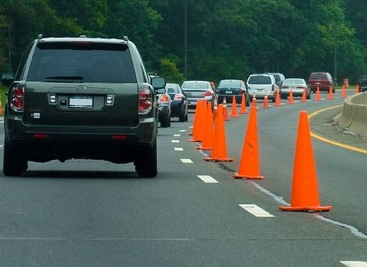
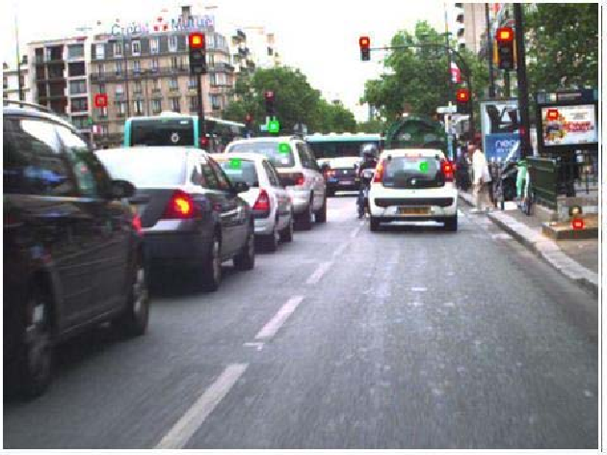
LITERATURE SURVEY
TITLE 1: The Utility of Shared Parking in Small Towns of Mixed Use Lands.
AUTHOR: GuoQingsheng, WengXiaoxiong, SongMinglei.
YEAR:2015
DESCRIPTION:
At present, the number of small town’s rapid growth of motor vehicles, the dynamic and static traffic put forward more requirements.
This paper first analyzes the characteristics of small town traffic, put forward the problems caused by the traffic congestion and parking is difficult because of small cities and towns, proposed the application of car sharing model is the effective measure to solve the problems.

Slide 5
At the same time, this paper defines the concept of the solve the traffic congestion utility index & the solve the parking difficulty utility index and has carried on the concrete application of.
The application sharing to solve the traffic congestion and parking is difficult to enhance the effectiveness of the obvious conclusion.
OBSERVATION :
Cones will be the easy identification for the drivers to park the car and if the traffic rules are obeyed properly then traffic congestion will be avoided.
On the other hand if roads are too narrow and cones are kept it will be difficult for drivers as well as travellers to travel there where the traffic congestion arises.

Slide 6
TITLE 2: Parking Assignment: Minimizing Parking Expenses and Balancing Parking Demand among Multiple Parking Lots.
AUTHOR: Oanh Tran Thi Kim, Nguyen H. Tran, Chuan Pham, Tuan LeAnh.
YEAR: 2019
DESCRIPTION:
Recently, a rapid growth in the number of vehicles on the road has led to an unexpected surge of parking demand. Consequently, ﬁnding a parking space has become increasingly difﬁcult and expensive.
One of the viable approaches is to utilize both public and private parking lots (PLs) to effectively share the parking spaces. However, when the parking demands are not balanced among PLs, a local congestion problem occurs where some PLs are overloaded, and others are underutilized.
Therefore, in this article, we formulate the parking assignment problem with two objectives:
minimizing parking expenses
balancing parking demand among multiple PLs.

Slide 7
First, we derive a matching solution for minimizing parking expenses. Then, we extend our study by considering both parking expenses and balancing parking demand, formulating this as a mixed integer linear programming problem.
We solve that problem by using an alternating direction method of multipliers (ADMM) based algorithm that can enable a distributed implementation. Finally, the simulation results show the ADMM-based algorithm produces performance gains up to 27.5% .
OBSERVATION :
Once the parking rate is minimized it will be useful for all the drivers to utilize the parking effectively.
If driver park the car for long period of time with no extra charges it will lead to loss for the owner economically.

Slide 8
TITLE 3: Smart Allocation Mechanism for Urban Parking
AUTHOR: Sujith John, R. Sujeetha, Advait N. Menon, Karthikeyan S
YEAR: 2019
DESCRIPTION:
The inspiration behind this paper arose from the need to reduce traffic congestions in urban localities caused by vehicles in search for parking spaces. It was found that almost 30% of traffic snarls in urban areas were caused by vehicles cruising for parking space, and it took the driver an average of 7.8 minutes to obtain a parking space on a regular basis.
The primary problem that we are trying to solve in this paper is the hassle of drivers having to obtain a parking slot in popular metropolitan neighbourhoods, particularly during rush hour time. Troubles arise from not being able to know where the available spaces are; and at this instance traffic congestions occur.
The second problem that is in focus is the valuable time wasted from inconvenient and under-equipped parking lots. A large amount of fuel is consumed while the vehicle idles while the driver looks around for parking lots, paving way to more CO2 emissions.
Finally, the last problem is all the potential collisions that may be caused by the sheer number of moving vehicles in disorganized parking lots.

Slide 9
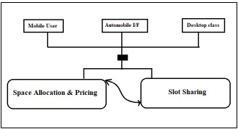
The newly developed system uses the One-sided–Vickrey Clarke Groves (O-VCG) auction algorithm for allotting parking spaces and keeps the database of available spaces online on the cloud, accessible to users through the web.
OBSERVATION:
The proposed system incorporates an IoT Cloud platform which is responsible for Smart Allocation & Pricing and Slot sharing service.
Within the IoT Framework, the Smart Gateway and Cloud data processing modules are present which helps in identifying and differentiating the public, street and private parking spaces.
Users from mobile, vehicle and desktop interfaces can access the service, making it easily available to large number of people without restricting them to a single interface.
The different parking arrival and departure scenarios are simulated and tested so that the system works in all the possible scenarios and doesn’t hinder the user.

Slide 10
TITLE 4: A Distribution Model for Shared Parking in Residential Zones that Considers the Utilization Rate and the Walking Distance.
AUTHOR: Wenhui Zhang, FanGao, ShuruiSun, QiuyingYu, JinjunTang, BohangLiu.
YEAR: 2020
DESCRIPTION:
Eﬃcient parking tends to be challenging in most large cities in China. Drivers often spend substantial amount so time looking for parking lots while driving at low speeds, thereby resulting in interference with road traﬃc. This paper focuses on eﬃciently allocating parking spaces to the demanders.
A double-objective model is proposed that considers both the utilizing rate and the walking distance. First, managers want utilize parking resources fully. However, demanders typically choose parking spaces according to convenience.

Slide 11
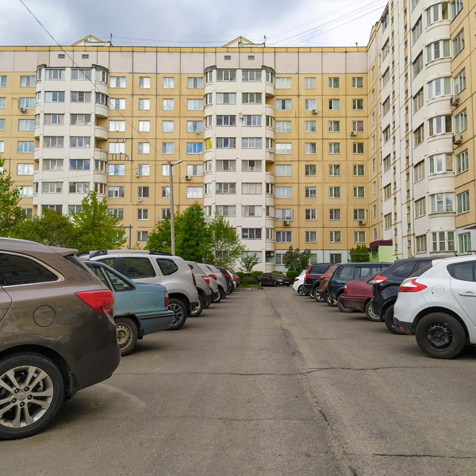
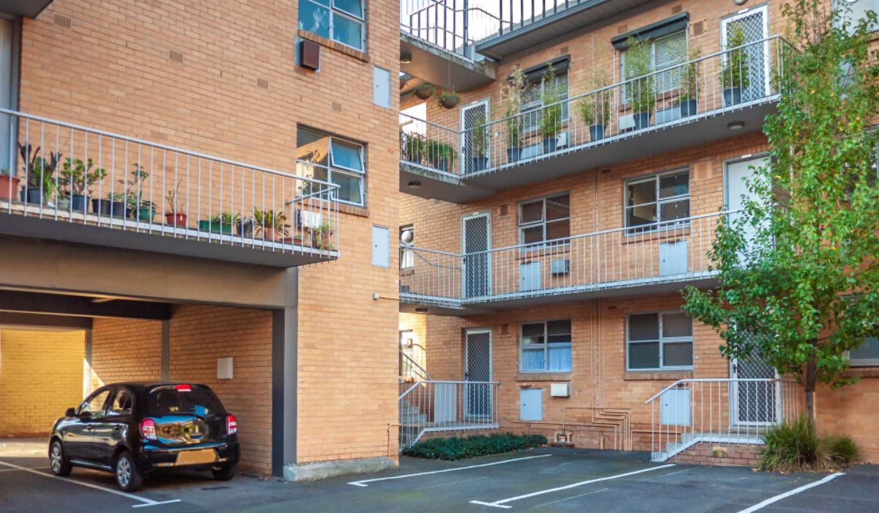
The second objective is the acceptable walking distance from the parking space to the destination. We collected parking demand and supply data in a central business district (CBD) of Harbin in China and evaluated the feasibility of the model.
The results demonstrate that the proposed model increases the occupying rates of parking lots in residential zones while decreasing the walking distance. The shared use of parking spaces maximizes the utility and alleviates the shortage of parking spaces in downtown.
OBSERVATION :
Once the parking is full then drivers automatically goes for the next parking lots which may increases the walking distance.

Slide 12
TITLE 5: Research on parking sharing strategies considering user overtime parking.
AUTHOR: Xin Huang, Xueqin Long, Jianjun Wang, LanHe.
YEAR: 2020
DESCRIPTION:
A parking sharing strategy is proposed to solve the problems of parking difficulty caused by the imbalance between parking spaces and parking demand. The vacant parking spaces of residential area can be efficiently utilized to meet the parking demands of those who are working at nearby or come for other activities based on the parking sharing strategy.
The paper analyzes the distribution of vehicle arrival numbers and parking durations, and then establishes a shared parking allocation model aiming to maximize the parking benefit considering the overtime parking behavior of the parking users.

Slide 13
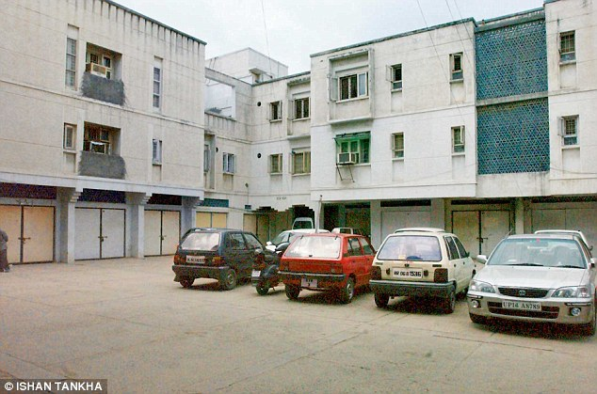
Simulation methods are used to the analyze the relationship among the parking benefit, proportion of reserved parking, numbers of parking demand, acceptance rate of parking demand and utilization of shared parking spaces. Then, based on that of maximum parking benefit, we can determine the optimal proportion of reserved parking, number of shared parking spaces that should be purchased from the residents.
Taking the utilization of shared parking spaces as an indicator, the validity of the static allocation is proved to be effective
OBSERVATION :
If duration increases amount to be paid also increases in that case the proposed model works actively.

Slide 14
PROBLEM DEFINITION
Nowadays, the availability of parking spaces is far behind the quick rising number of cars. Rather than building more lots, a better way is to share private-owned parking spaces. However, this faces the challenge that users are not willing to expose their privacy to the public.
The increasing rate of private car usage in the urban areas as a result of fast-growing economy, derelict policies and subsidies are the main causes making car parking one of the main concerns for transport and traffic management all over the world.
The coordination between parking policies and traffic management revealed how parking is becoming a barrier to the through-traffic operation. Also, it is responsible for the inefficient use of available resources, even the decisions are made on an ad-hoc basis while making policy.
Hence, it is necessary to understand the parking choice behaviour and actual demand of parking space. By parking the vehicle in public place the vehicle can be claimed by towing person but in this case there is no towing problems and no need to give fine for anything we can park our vehicle with securely.
To solve this problem, we propose a new architecture for parking space sharing, into the design of a secure protocol for parking space searching and booking by using maps.

Slide 15
FEASIBILITY STUDY
ECONOMIC FEASIBILITY
Economic feasibility attempts to weigh the cost of developing and implementing a new system, against the benefits that would accurate from having the new system in place.
This feasibility study gives the top management the economic justification for the new system. A simple economic analysis which gives the actual comparison of costs and benefits are much more meaningful in this case.
In addition, this proves to be a useful point of reference to compare actual costs as the project progresses. These could include increased customer satisfaction, improved accuracy of operation, better documentation and recordkeeping, faster retrieval of information.
SCHEDULE FEASIBILITY
Schedule Feasibility means that the project can be completed on time.
The project does not have a deadline but according to the proposed system the development process is on schedule. Therefore it is feasible.

Slide 16
OPERATIONAL FEASIBILITY
Proposed project is beneficial only if it can be turned into information systems that will meet the organization operating requirements.
Simply stated, this test of feasibility asks if the system will work when it is developed and installed.
TECHNICAL FEASIBILITY
This project is based on free space allocation system and driver guiding system to free space. Urban parking building always a busy place to drivers even if it has free space it is difficult to find that place for a driver. They will have to waste lot of time and fuel to find a free space.
As we introduce MAPS, it will guide the driver shortest possible time in to free space and also it does the communication with IR sensors which are implemented in each and every parking slot.
Then the MAP will display information and direction of available space or exit.

Slide 17
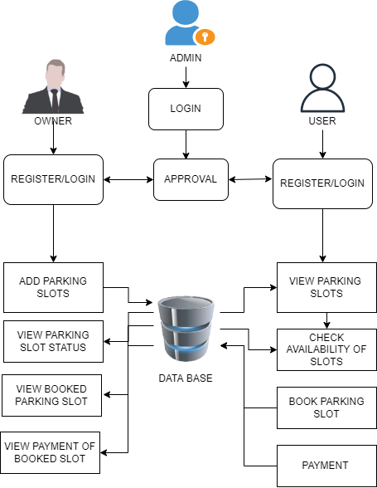
SYSTEM ARCHITECTURE

Slide 18
Thank You!

